Slide 1
Programming Circle
Developing a simple Android game using Xamarin
Presented by:
Umer, Elena, Shukry, Poulad

Slide 2
Overview
Layout Management
Implementation of Game
Activity Life Cycle
Implicit intent
Weight & Gravity
Assigned Tasks

Slide 3
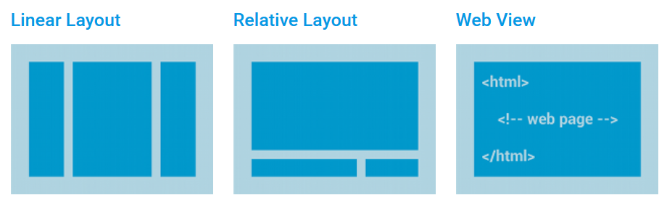
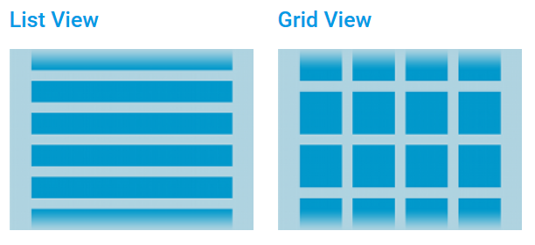
Notes:
Layouts control a visual structure of screen display. There are some common layouts on the slide. In our game, we are going to use linear layouts. Linear layouts organize its children in an horizontal or vertical row.

Slide 4
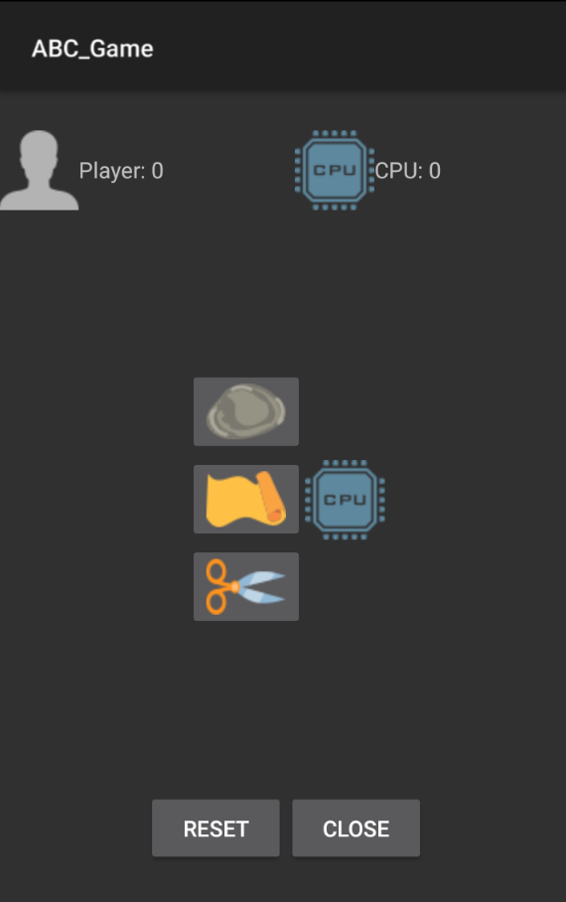
LinearLayout (V)
LinearLayout (H)
LinearLayout (H)
LinearLayout (H)
LinearLayout (H)
LinearLayout (V)
LinearLayout (H)
Notes:
How to use linear layout to manage the view of the activity.

Slide 5
1
4
7
8
ivPlayer
ibRock
1
2
2
5
ImageView
ivCPU
ImageButton
ibPaper
3
6
ivCPUChoice
ibScissors
4
3
5
6
7
9
tvPlayerScore
bReset
TextView
Button
8
10
9
10
tvCPUScore
bClose
Notes:
This shows how we use android:id attribute to give our View elements on our activity an ID

Slide 6
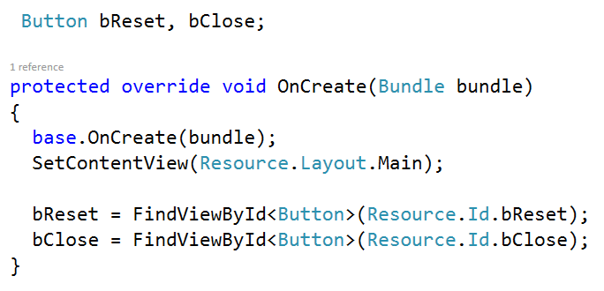
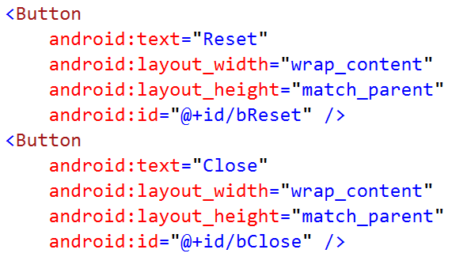
public T FindViewById<T> (int id)
Finds a view that was identified by the id attribute from the Layout that was processed.

Slide 7
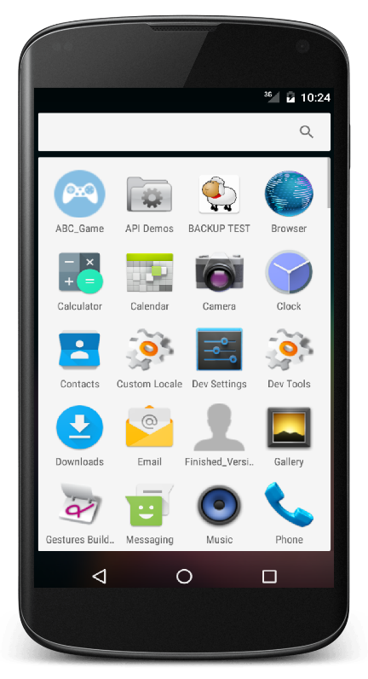
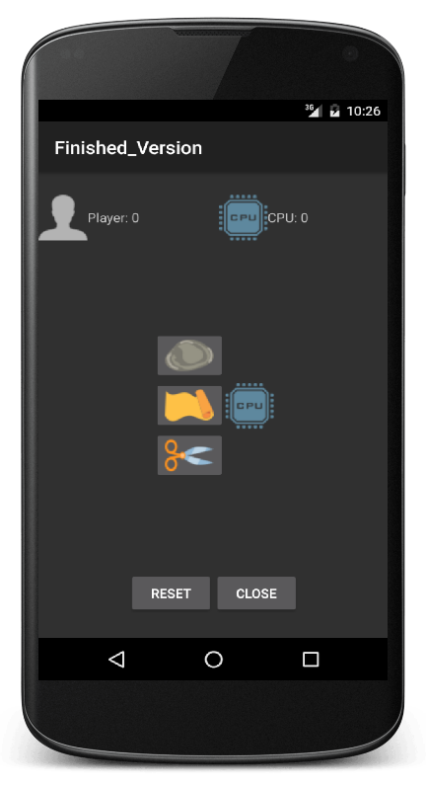
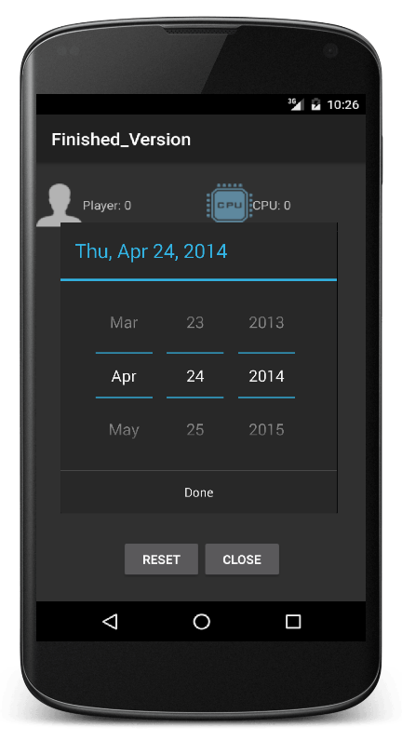
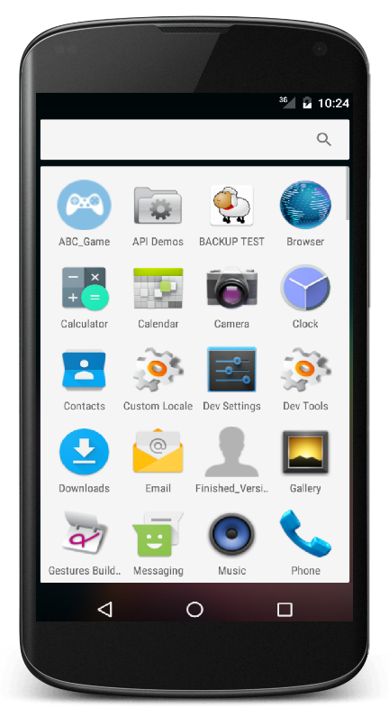
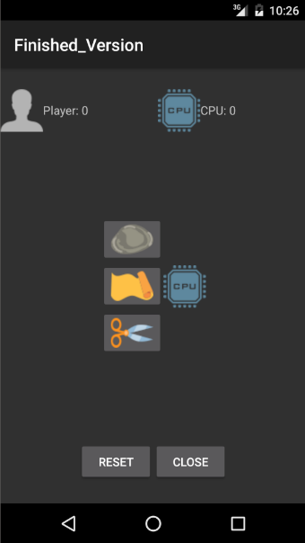
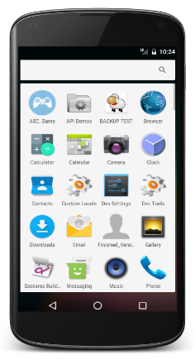
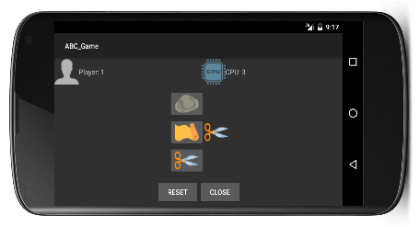
Activity Life Cycle
OnRestart()
OnCreate()
OnStart()
OnResume()
OnPause()
OnStop()
OnDestroy()
OnRestoreInstanceState()
OnSaveInstanceState()
Launch
Running
Partially Visible
Not Visible
Shut Down
Rotated
Notes:
onCreate = the only mandatory activity lifecycle methods
onResume = should be light-weight method; I must be able to execute multiple times – form and back to application
onPause = similar to the above method; should also be light-weight
To save activity’s state: OnSaveInstanceState()
To restore activity’s state: OnRestoreInstanceState()

Slide 8
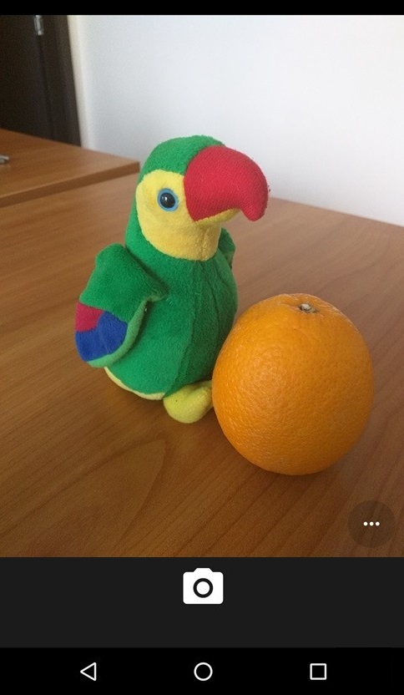

Implicit intent
ABC Game
(Main Activity)
Intent
Intent
StartActivityForResult()
OnActivityResult()
Intent
Intent
Notes:
intents are used to open components.
Implicit intents are used to request actions. Implicit intents do not name a specific component, but instead declare a general action to perform.
We can pass that intent to the method StartActivityForResult().
In our application, we send an intent to the android OS for capturing an image.
Android OS sends that intent to the camera application.
If user captured the image, an intent(containing image’s thumbnail) would be passed back to our activity.
We can get that data in OnActivityResult() method.

Slide 9
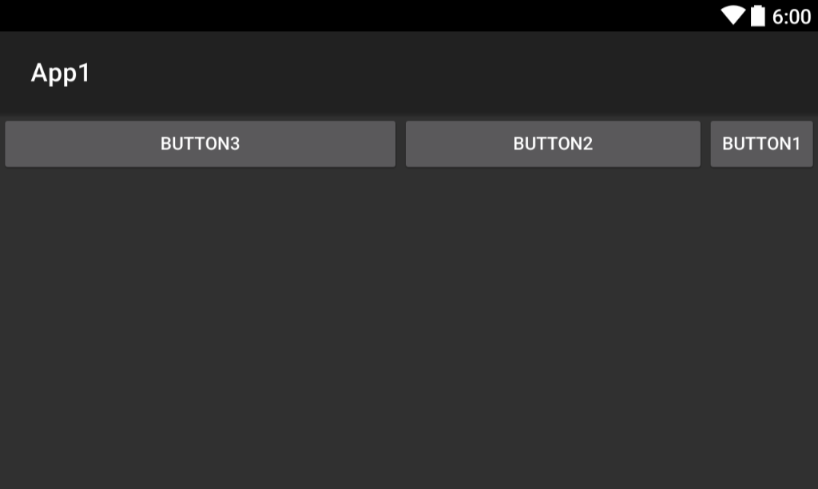
android:layout_weight="3"
android:layout_weight= "1"
android:layout_weight= "2"
android:orientation="horizontal"
android:weightSum="5"
Notes:
LinearLayout also supports assigning a weight to individual children with the android:layout_weight attribute. This attribute assigns an "importance" value to a view in terms of how much space it should occupy on the screen.

Slide 10
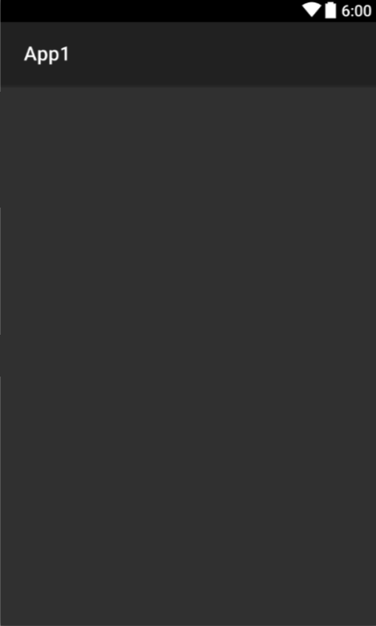

android:gravity sets the gravity of its content (children)
<LinearLayout
android:orientation="vertical"
android:gravity="center_vertical" >
LinearLayout

Slide 11
android:gravity sets the gravity of its content (children)
android:layout_gravity sets the gravity of the View element in its parent.
<LinearLayout
android:orientation="vertical" >
</LinearLayout>
LinearLayout
<Button
android:text="Button1"
android:layout_width="wrap_content"
android:layout_height="wrap_content"
android:layout_gravity="right" />
Button

Slide 12
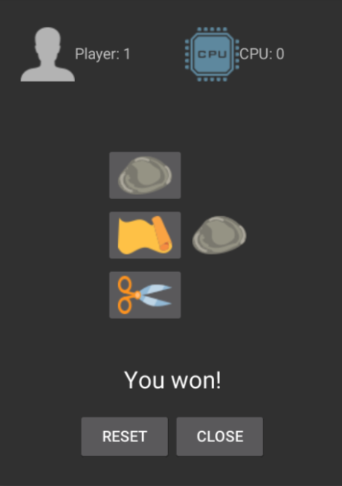
Things left for you!
Lambda Expressions
Reset Button:
Change the CPUChoice image to CPU’s image
Reset player’s image to its default image
Close Button:
Show a toast that states the result of the game
[ Player / CPU ] won! / Draw!
Saving activity’s state
Maintain the CPU’s choice during the life cycle and set
the picture accordingly
Feel free to change the layout

